Slide 1
2024
Low Level Design
BUDGET SALES ANALYSIS
AMAN PRATAP SINGH

Slide 2
1 Low Level Design
Written By | AMAN PRATAP SINGH
Document Version | 1.0
Last Revised Date
01-03-2024
DOCUMENT CONTROL
Change Record:
VERSION | DATE | AUTHOR | COMMENTS
Reviews:
VERSION | DATE | REVIEWER | COMMENTS
Approval Status:
VERSION | REVIEW DATE | REVIEWED BY | APPROWED BY | COMMENTS

Slide 3
2 Low Level Design
Table of Contents
1. Introduction ......................................................................................... 3
1.1 What is Architecture design document? ......................... 3
1.2 Scope ................................................................................................. 3
Architecture ............................... 6.
Data source ....................... .
Data ingestion................. ..
Data warehouse .............. .
BI semantic models ..... 8 ..
2.5 Report .................................. .

Slide 4
3 Low Level Design
Introduction
What is Low-level design document?
The goal of the Low-level design document (LLDD) is to give the internal logic design of the actual program code for the Sales Budget Analysis dashboard. LLDD describes the class diagrams with the methods and relations between classes and programs specs. It describes the modules so that the programmer can directly code the program from the document.
Scope
Low level design (LLD) is a component-level design process that follows a step-by-step refinement process. The process can be used for designing data structures, required software architecture, source code and ultimately, performance algorithms. Overall, the data organization may be defined during requirement analysis and then refined during data design work.
Project Introduction
The growth of manufacturing and reselling business in most populated cities are increasing and market competitions are also high. The dataset is one of the historical sales of a company named Adventure Works which has records for 3 years. Good data driven systems for analysing sales can improve the performance of the company and generate more ROI to the stakeholders.

Slide 5
4 Low Level Design
2. Problem Statement
Our "Domain Sale" process is structured to help potential buyers purchase the domain they want immediately without the hassle of contacting the seller directly.
A seller lists a domain for sale at a specific price in our Marketplace. An interested buyer sees this domain for sale and decides to buy it.
3. Dataset information
CustomerKey: Primary key for customer dataset Birthdate: Birthdate of the customer MaritalStatus: M- Married / S - Single
Gender: M – Male / F – Female
TotalChildren: Total number of children
NumberChildrenAtHome: Number of children staying along with their parents
Education: Education qualification
Occupation: Present occupation
HouseOwnerFlag: 1– Owns house / 0- Doesn’t have a permanent
address
NumberCarsOwned: Number of cars owned by the customer
DateFirstPurchase: First date of order by the customer

Slide 6
5 Low Level Design
ProductKey: Primary Key for the product dataset ProductName: Product name with colour of the product Subcategory: Sub category name of the product Category: Category name of the product
ListPrice: Sale price of the product
DaysToManufacture: Days to manufacture the product after receiving the order
ProductLine: Product line name
ModelName: Model name of the product ProductDescription: more details about the product SalesTerritoryKey: Primary Key of the Territory dataset Region: Region name of the order
Country: Country name of the order
OrderDate: Date of the order received
ShipDate: Date when the order left the factory for export SalesOrderNumber: Invoice number of the order OrderQuantity: Number of quantities ordered for a product UnitPrice: Per unit sale price of the product TotalProductCost: Cost of the product
SalesAmount: Total sales price of the product
TaxAmt: Tax collected for the product sold

Slide 7












6 Low Level Design
4. Architecture
Collect Raw Data
Importing Libraries
Load Dataset
Merging Data
Exploring Data
Adding Columns
Handling Missing Data
Assessing Data
Modeling
Creating Measures
Power BI Report
Insights
Deployment
Documentation
Collect Raw Data - This step involves extracting the data from different sources relevant to the problem statement or obtaining data from the client
Importing Libraries – Import analysis related python libraries example – Pandas, Numpy, Plotly, datetime etc
Data Wrangling – Contains following steps gathering data, assessing data, handling missing data and adding columns

Slide 8
7 Low Level Design
Exploring Data – Once the data is loaded and pre-processed, we preform data analysis using python libraries and Business Intelligence tools like Power BI
Data Modelling - Data Modelling is one of the features used to connect multiple data sources in BI tool using a relationship.
A relationship defines how data sources are connected with each other and you can create interesting data visualizations on multiple data sources
Deployment - The prepared visualizations are deployed on the powerbi.microsoft.com site. Where they will be available publicly

Slide 9
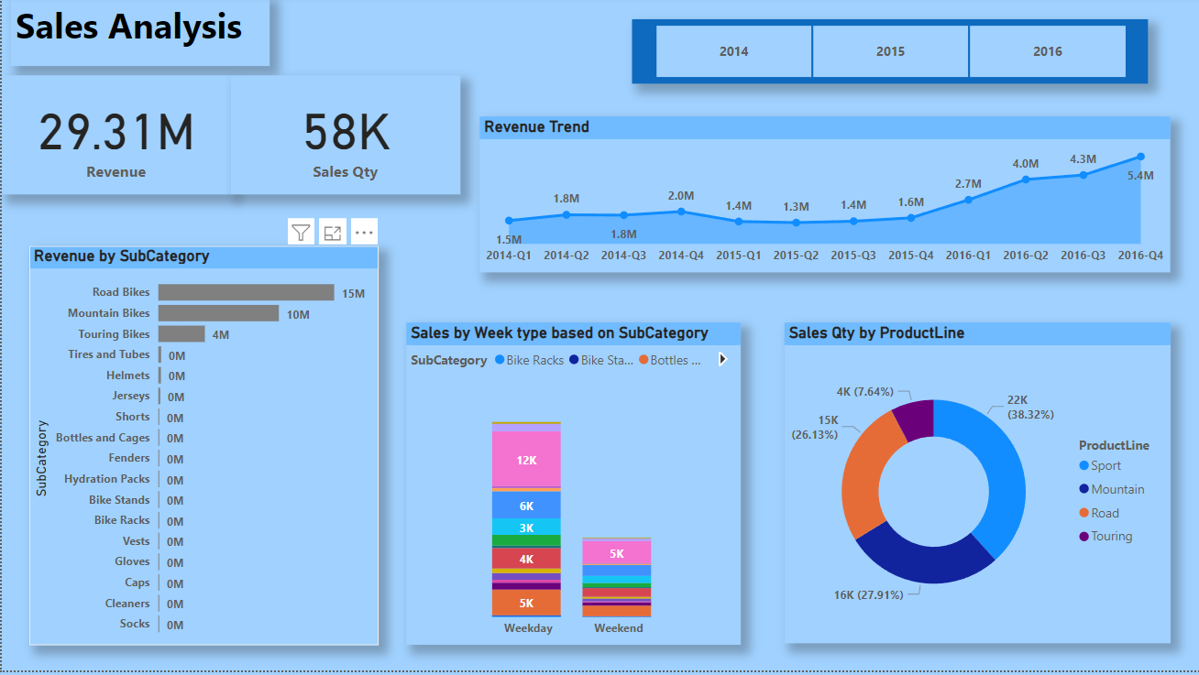
8 Low Level Design

Slide 10
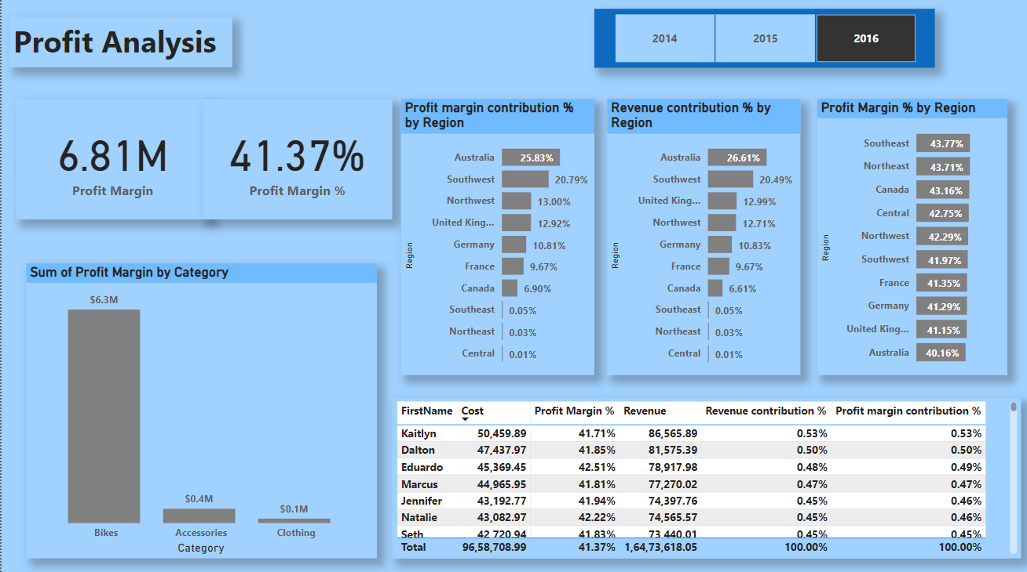
9 Low Level Design

Slide 11
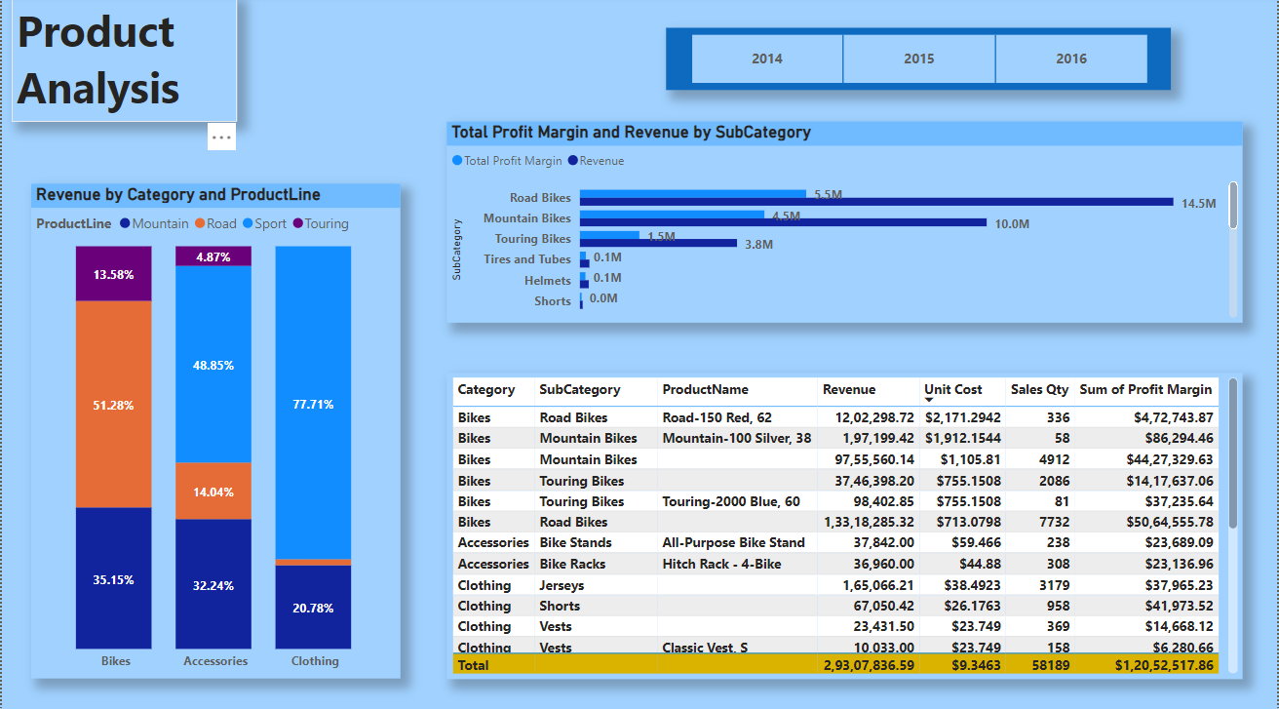
10 Low Level Design

Slide 12
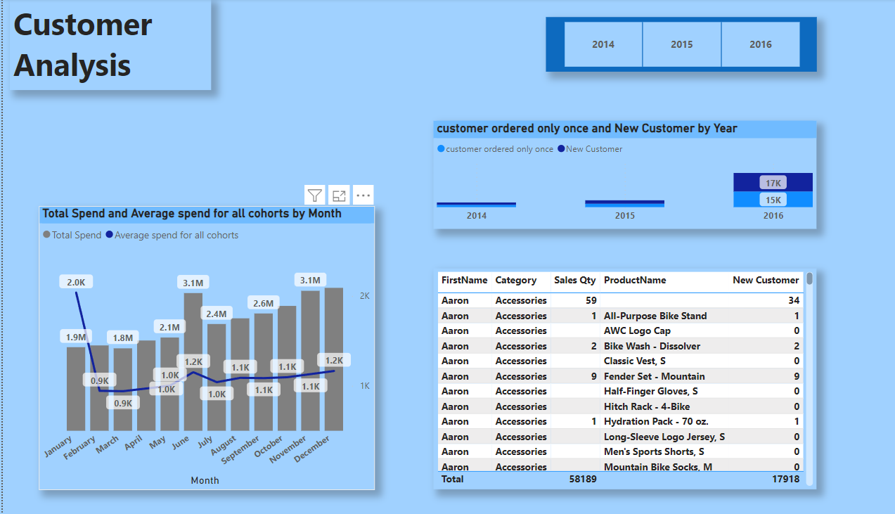
11 Low Level Design

